Slide 1
Client Side Scripting Language
JavaScript

Slide 2
Objective
To learn
  Objects and methods
  Javascript Errors
  Exception handling
  Built-in and Customized objects in exception handling
Jackson, Web Technologies: A Computer Science Perspective, © 2007 Prentice-Hall, Inc. All rights reserved. 0-13-185603-0

Slide 3
Outcome
Students will be able to
  Write their own objects
  Understand errors and exception handling
  Write customized objects in exception handling
Jackson, Web Technologies: A Computer Science Perspective, © 2007 Prentice-Hall, Inc. All rights reserved. 0-13-185603-0

Slide 4
Context
HTML and CSS were helpful in designing non-interactive website
However, Javascript is useful to create interactive website
Javascript objects are useful to create customized error for exception handling
Jackson, Web Technologies: A Computer Science Perspective, © 2007 Prentice-Hall, Inc. All rights reserved. 0-13-185603-0

Slide 5
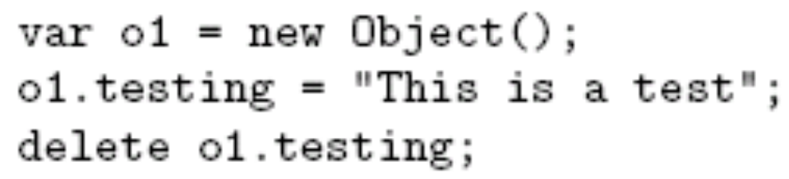
Object Introduction
There are no classes in JavaScript
Instead, properties can be created and deleted dynamically
Create an object o1
Create property testing
Delete testing property
Guy-Vincent Jourdan :: CSI 3140 :: based on Jeffrey C. Jackson’s slides

Slide 6

Object Creation
Objects are created using new expression
A constructor is a function
  When called via new expression, a new empty Object is created and passed to the constructor along with the argument values
  Constructor performs initialization on object
    Can add properties and methods to object
    Can add object to an inheritance hierarchy
Constructor and argument list
Guy-Vincent Jourdan :: CSI 3140 :: based on Jeffrey C. Jackson’s slides

Slide 7
Property Creation
Assignment to a non-existent (even if inherited) property name creates the property:
Object initializer notation can be used to create an object (using Object() constructor) and one or more properties in a single statement:
Guy-Vincent Jourdan :: CSI 3140 :: based on Jeffrey C. Jackson’s slides

Slide 8
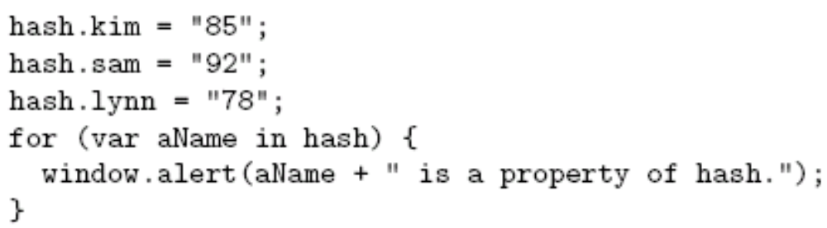
Enumerating Properties
Special form of for statement used to iterate through all properties of an object:
Produces three
alert boxes;
order of names
is implementation-dependent.
Guy-Vincent Jourdan :: CSI 3140 :: based on Jeffrey C. Jackson’s slides

Slide 9

Accessing Property Values
The JavaScript object dot notation is actually shorthand for a more general associative array notation in which Strings are array indices:
Expressions can supply property names:
Converted to String
if necessary
Guy-Vincent Jourdan :: CSI 3140 :: based on Jeffrey C. Jackson’s slides

Slide 10
Example – creation of object
<html> <body> <script>
function person(x) { this.age=x; }
var x=window.prompt("Enter the age","");
var p=new person(x);
window.alert("Age is " + p.age);
p.isAge=function age() {
window.alert("From the function "+this.age);
}
p.isAge(); </script> </body> </html>
Jackson, Web Technologies: A Computer Science Perspective, © 2007 Prentice-Hall, Inc. All rights reserved. 0-13-185603-0

Slide 11
Example – Iteration of properties
<html>
<head>
<script type = "text/javascript">
var o1=new Object();
o1.x=10; o1.y=20; o1.z=30;
for (i in o1) {
window.alert("Property name "+i);
window.alert("Property value "+o1[i]);
}
</script>
</head> </html>
Guy-Vincent Jourdan :: CSI 3140 :: based on Jeffrey C. Jackson’s slides

Slide 12
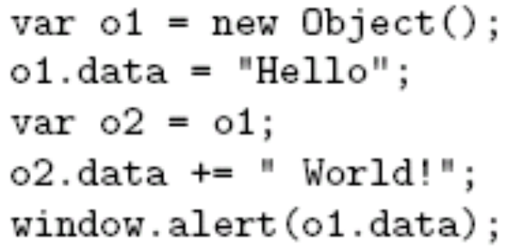
Object Values
Value of Object is reference to object:
Guy-Vincent Jourdan :: CSI 3140 :: based on Jeffrey C. Jackson’s slides

Slide 13
Object Values
Value of Object is reference to object:
o2 is another
name for o1
Guy-Vincent Jourdan :: CSI 3140 :: based on Jeffrey C. Jackson’s slides

Slide 14
Object Values
Value of Object is reference to object:
o1 is
changed
Guy-Vincent Jourdan :: CSI 3140 :: based on Jeffrey C. Jackson’s slides

Slide 15
Object Values
Value of Object is reference to object:
Output is Hello World!
Guy-Vincent Jourdan :: CSI 3140 :: based on Jeffrey C. Jackson’s slides

Slide 16
Example
<html> <head>
<script type = "text/javascript">
var o1=new Object(); o1.data="Hello";
o2=o1;
o1.data+="World“
window.alert("Value of o1 is " +o1.data);
window.alert("Value of o2 is " +o2.data);
</script> </head> </html>
Guy-Vincent Jourdan :: CSI 3140 :: based on Jeffrey C. Jackson’s slides

Slide 17
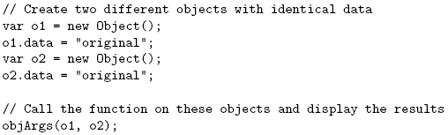
Object Values
Object argument values are references
...}
Guy-Vincent Jourdan :: CSI 3140 :: based on Jeffrey C. Jackson’s slides

Slide 18
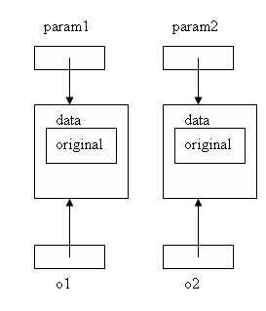
Object Values
Object argument values are references
Guy-Vincent Jourdan :: CSI 3140 :: based on Jeffrey C. Jackson’s slides

Slide 19
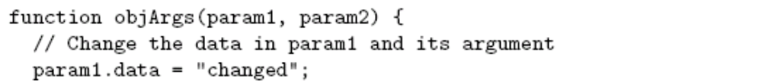
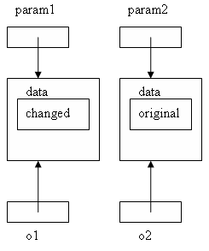
Object Values
Object argument values are references
Guy-Vincent Jourdan :: CSI 3140 :: based on Jeffrey C. Jackson’s slides

Slide 20
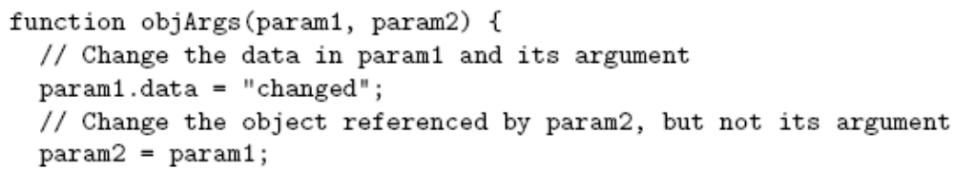
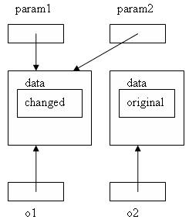
Object Values
Object argument values are references
Guy-Vincent Jourdan :: CSI 3140 :: based on Jeffrey C. Jackson’s slides

Slide 21
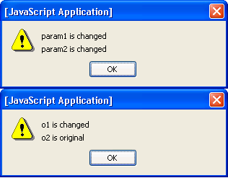
Object Values
Object argument values are references
Guy-Vincent Jourdan :: CSI 3140 :: based on Jeffrey C. Jackson’s slides

Slide 22
Javascript – Errors
Syntax Error
Runtime Error
Logical Error
Jackson, Web Technologies: A Computer Science Perspective, © 2007 Prentice-Hall, Inc. All rights reserved. 0-13-185603-0

Slide 23
Syntax Error
Occur at compile time
<script type = "text/javascript">
<!--
window.print(; #missing a closing parenthesis
//-->
</script>
When a syntax error occurs in JavaScript, only the code contained within the same thread as the syntax error is affected and the rest of the code in other threads gets executed assuming nothing in them depends on the code containing the error
Jackson, Web Technologies: A Computer Science Perspective, © 2007 Prentice-Hall, Inc. All rights reserved. 0-13-185603-0

Slide 24
Runtime Error
Occur during execution (after compilation/interpretation)
Here the syntax is correct, but at runtime, it is trying to call a method that does not exist
<script type = "text/javascript">
window.printme();
</script>
Exceptions also affect the thread in which they occur, allowing other JavaScript threads to continue normal execution
Jackson, Web Technologies: A Computer Science Perspective, © 2007 Prentice-Hall, Inc. All rights reserved. 0-13-185603-0

Slide 25
Logical Error
Logic errors are not the result of a syntax or runtime error
Instead, they occur when make a mistake in the logic that drives the script
Cannot catch those errors, because it depends on the business requirement
Jackson, Web Technologies: A Computer Science Perspective, © 2007 Prentice-Hall, Inc. All rights reserved. 0-13-185603-0

Slide 26
Components of Exception Handling
The try statement lets you test a block of code for errors
The catch statement lets you handle the error
The throw statement lets you create custom errors
The finally statement lets you execute code, after try and catch, regardless of the result
Jackson, Web Technologies: A Computer Science Perspective, © 2007 Prentice-Hall, Inc. All rights reserved. 0-13-185603-0

Slide 27
Example
<html>
<body>
<p>Please input a number between 5 and 10:</p>
<input id="demo" type="text">
<button type="button" onclick="myFunction()">Test Input</button>
<p id="p01"></p>
Jackson, Web Technologies: A Computer Science Perspective, © 2007 Prentice-Hall, Inc. All rights reserved. 0-13-185603-0

Slide 28
Example
<script>
function myFunction() {
var message, x;
message = document.getElementById("p01");
message.innerHTML = "";
x = document.getElementById("demo").value;
try {
if(x == "") throw "empty";
Jackson, Web Technologies: A Computer Science Perspective, © 2007 Prentice-Hall, Inc. All rights reserved. 0-13-185603-0

Slide 29
Example
if(isNaN(x)) throw "not a number";
x = Number(x);
if(x < 5) throw "too low";
if(x > 10) throw "too high";
}
catch(err) {
message.innerHTML = "Input is " + err;
}
}
</script>
</body>
</html>
Jackson, Web Technologies: A Computer Science Perspective, © 2007 Prentice-Hall, Inc. All rights reserved. 0-13-185603-0

Slide 30
Reference Error
<html> <body>
<h2>JavaScript Errors</h2>
<p>You cannot use the value of a non-existing variable:</p>
<p id="demo"></p>
<script>
var x;
try { x = y + 1; }
catch(err) { document.getElementById("demo").innerHTML = err.name; }
</script>
</body>
</html>
Jackson, Web Technologies: A Computer Science Perspective, © 2007 Prentice-Hall, Inc. All rights reserved. 0-13-185603-0

Slide 31
Type Error
<html> <body>
<h2>JavaScript Errors</h2>
<p>You cannot convert a number to upper case:</p>
<p id="demo"></p>
<script>
var num = 1;
try { num.toUpperCase(); }
catch(err) { document.getElementById("demo").innerHTML = err.name; }
</script>
</body>
</html>
Jackson, Web Technologies: A Computer Science Perspective, © 2007 Prentice-Hall, Inc. All rights reserved. 0-13-185603-0

Slide 32
Divide by zero error
<html> <head>
<script type = "text/javascript“>
function myFunc()
{
var a = 100; var b = 0;
try { if ( b == 0 ) throw( "Divide by zero error." );
else var c = a / b;
}
catch ( e ) { alert("Error: " + e ); }
}
</script> </head>
Jackson, Web Technologies: A Computer Science Perspective, © 2007 Prentice-Hall, Inc. All rights reserved. 0-13-185603-0

Slide 33
Divide by zero error
<body>
<form>
<input type = "button" value = "Click Me" onclick = "myFunc();" />
</form>
</body>
</html>
Jackson, Web Technologies: A Computer Science Perspective, © 2007 Prentice-Hall, Inc. All rights reserved. 0-13-185603-0

Slide 34
Divide by zero error – customized object
<html> <head>
<script type = "text/javascript“>
function myFunc()
{
alert("Hi");
var a = 100;
var b = 0;
// Create an object:
function divideByZero(x)
{
this.name=x;
this.message="Dividend should not be zero";
}
Jackson, Web Technologies: A Computer Science Perspective, © 2007 Prentice-Hall, Inc. All rights reserved. 0-13-185603-0

Slide 35
Divide by zero error – customized object
try {
if ( b == 0 ) {
var e=new divideByZero("Divide By Zero Error");
throw e;
}
else var c = a / b;
}
catch ( e ) {
alert("Error: " + e.name);
alert("Error: " + e.message);
} } </script>
Jackson, Web Technologies: A Computer Science Perspective, © 2007 Prentice-Hall, Inc. All rights reserved. 0-13-185603-0

Slide 36
Divide by zero error – customized object
<form>
<input type = "button" value = "Click Me" onclick = "myFunc();" />
</form>
</body>
</html>
Jackson, Web Technologies: A Computer Science Perspective, © 2007 Prentice-Hall, Inc. All rights reserved. 0-13-185603-0

Slide 37
Simple Questions
Whether class concept exists in javascript
How to initialize the object?
How to iterate through the properties of the object
How syntax error is different from runtime error?
How these errors are handled in javascript?
Jackson, Web Technologies: A Computer Science Perspective, © 2007 Prentice-Hall, Inc. All rights reserved. 0-13-185603-0

Slide 38
References
www.w3schools.com
Deitel and Deitel and Nieto, ―Internet and World Wide Web - How to Program‖, Prentice Hall, 5th Edition, 2011.
Jeffrey C and Jackson, ―Web Technologies A Computer Science Perspective‖, Pearson Education, 2011.
Jackson, Web Technologies: A Computer Science Perspective, © 2007 Prentice-Hall, Inc. All rights reserved. 0-13-185603-0

Slide 39
Summary
Students will be able to
  Write their own objects
  Utilize built-in objects
  Write exception handling methods using built-in objects
  Write exception handling methods using customized objects
Jackson, Web Technologies: A Computer Science Perspective, © 2007 Prentice-Hall, Inc. All rights reserved. 0-13-185603-0

